Slide 1
Dr . SNS RAJALAKSHMI COLLEGE OF ARTS AND SCIENCE
COIMBATORE
Cloud Application Development
Mr .C .RAJKUMAR
Department of Computer Applications

Slide 2
UNIT I :
Introduction - Cloud computing at a glance -Historical developments - Building cloud computing environments. Virtualization: Introduction – Characteristics of virtualized environments – Increased security – Managed execution – Portability- Taxonomy of virtualization techniques – Execution virtualization – Other types of virtualization – Virtualization and cloud computing – Pros and cons of virtualization – Advantages of virtualization – The other side of the coin: disadvantages.

Slide 3
What is Cloud Computing?
Cloud computing is the on-demand delivery of IT services over the internet at a pay-as-you-go pricing model.
Let us explain what the highlighted words mean.
On-demand: The service delivered is strictly based on your needs and specifications that suit your usage.
IT services: These include compute instances, storage, networking, security, software, etc.
Internet: The above IT services are delivered over the internet and do not require physical connections and installations.

Slide 4
Pay-as-you-go: This is a pricing system whereby one will only be charged up to the extent that one uses a service. That is to say, there is no upfront payment.
Some popular cloud service providers are: · Amazon Web Service (AWS) · Microsoft Azure · Google Cloud Provider (GCP) · Digital Ocean · IBM Cloud

Slide 5
Examples of cloud services include:
· Compute — examples include remote servers, virtual machines such as Amazon EC2, Azure Virtual Machines, Google Cloud Kubernetes Engine
· Storage — examples include: Azure Blob Storage, Amazon S3, IBM Cloud Block Storage
· Networking: Amazon Virtual Private Cloud (VPC), Azure Virtual Network (VNet), Google Cloud DNS
· Security _ examples include Google Cloud Key Management Services (KMS), AWS IAM, and Azure Key Vault.

Slide 6
What is the Cloud?
Cloud services are delivered remotely (via wireless), it makes sense to refer to them as being delivered over the cloud.
However, from the perspective of cloud providers, the cloud consists of physical infrastructure (servers) that are made available via the internet.

Slide 7
Types of Cloud services:
Cloud services are majorly classified into three (3) types
· Infrastructure as a Service (IaaS)
· Platform as a Service (PaaS)
· Software as Service (SaaS)

Slide 8
Platform as a Service (PaaS) -: This is a cloud computing service that allows the users to provision, instantiate, develop and deploy applications and software without the complexity of building and maintaining the infrastructure that is associated with running the applications.

Slide 9
Software as a Service (SaaS) -: In this type of cloud computing service applications are delivered over the internet and the user only needs to learn how to use the application.

Slide 10
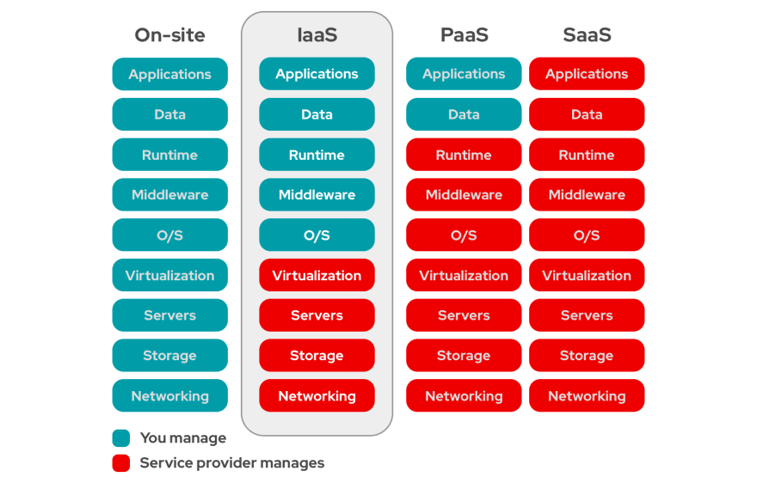

Slide 11
Historical development of Cloud Computing
In 1950 the main frame and time sharing are born, introducing the concept of shared computer resources.
During this time word cloud was not in use.
Cloud computing is believed to have been invented by Joseph Carl Robnett Licklider in the 1960s with his work on ARPANET to connect people and data from anywhere at any time.
In 1969 the first working prototype of ARPANET is launched.
In 1970 the word “Client-Server” come in to use.

Slide 12
Client server defines the computing model where client access the data and applications from a central server.
In 1995, pictures of cloud are started showing in diagrams, for not technical people to understand.

Slide 13
In 1999 the salesforce.com was launched, the first company to make enterprise applications available from a website.
In 1999, the search engine Google launches.
In 1999, Netflix was launched, introducing the new revenue way.
In 2004 Facebook launches giving users facility to share themselves.
In 2006, Amazon launched Amazon Web Services(AWS), giving users a new way.

Slide 14
In2006, Google CEO Eric Schmidt uses the word “cloud” as an industry event.
In 2007, Apple launches iPhone, which could be used on any wireless network.
In 2007, Netflix launches streaming services, and live video watching is born.
In 2008, private cloud come in to existence.
In 2009, browser based application like google apps are introduced.

Slide 15
In 2010, hybrid cloud (private+public cloud) comes in to existence.
In 2012, Google launches google drive with free cloud storage.
Now cloud adoption is present, which makes cloud computing more stronger.
The IT services progressed over the decades with the adoption of technologies such as Internet Service Providers (ISP) Application Service Providers.

Slide 16
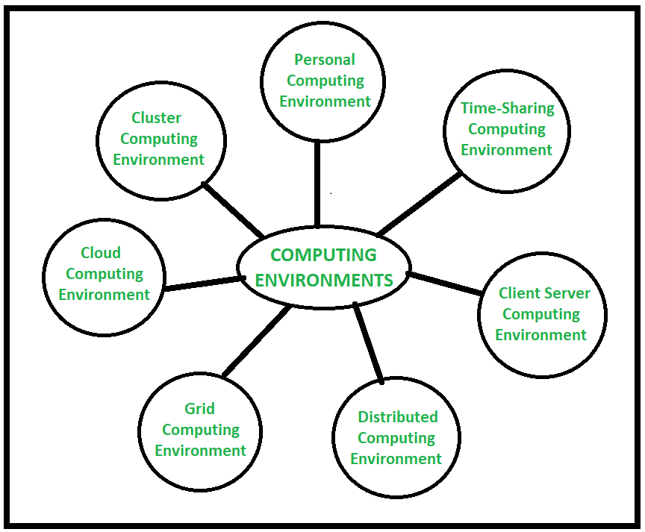
Building cloud computing environments

Slide 17
Characteristics of virtualized environments
Virtualization is abroad concept that refers to the creation of a virtual version of something, whether hardware, a software environment, storage, or a network. In a virtualized environment there are three major components: guest, host, and virtualization layer.

Slide 18
The guest represents the system component that interacts with the virtualization layer rather than with the host, as would normally happen. The host represents the original environment where the guest is supposed to be managed.

Slide 19
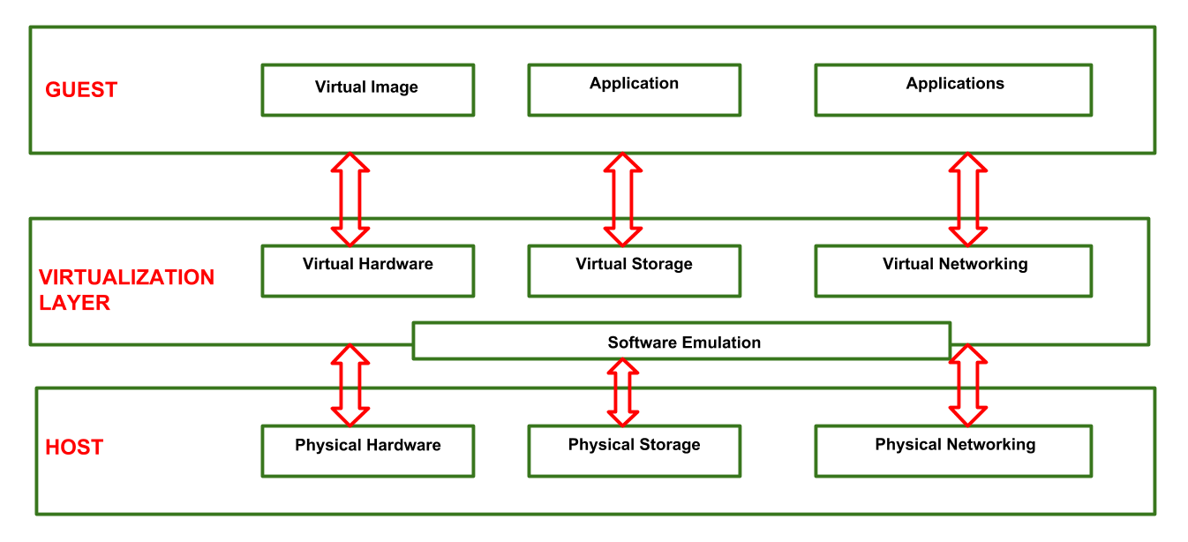

Slide 20
1.1.Increased security
The ability to control the execution of a guest in a completely transparent manner opens new possibilities for delivering a secure, controlled execution environment.
1.2. Managed execution
Virtualization of the execution environment not only allows increased security, but a wider range of features also can be implemented. In particular, sharing, aggregation, emulation, and isolation are the most relevant features

Slide 21
1.3. Portability
The concept of portability applies in different ways according to the specific type of virtualization considered. In the case of a hardware virtualization solution, the guest is packaged into a virtual image that, in most cases, can be safely moved and executed on top of different virtual machines

Slide 22
Taxonomy of virtualization techniques
Virtualization covers a wide range of emulation techniques that are applied to different areas of computing.
A classification of these techniques helps us better understand their characteristics and use
Virtualization is mainly used to emulate
execution environments, storage, and networks.

Slide 23
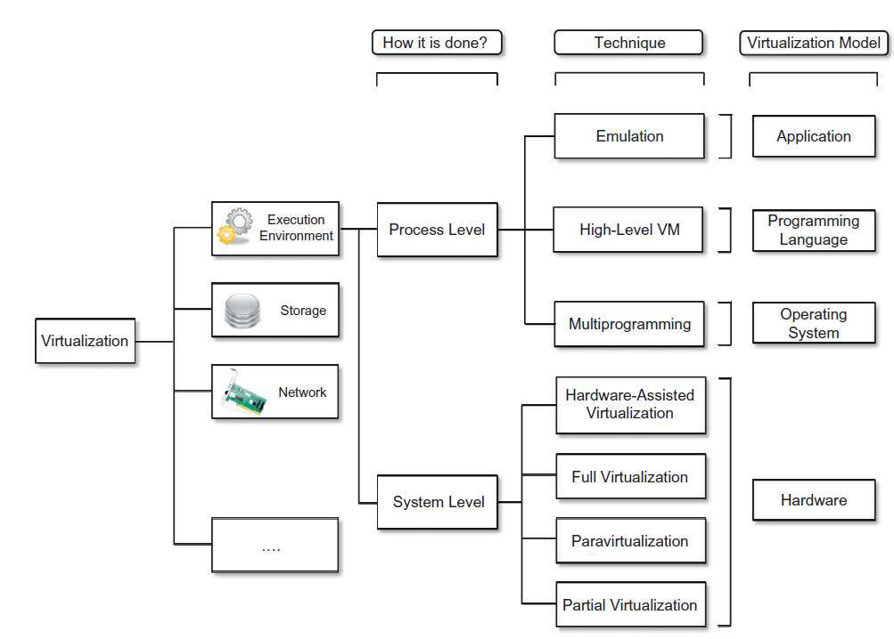

Slide 24
Among these categories, execution virtualization
constitutes the oldest, most popular, and most developed area. Therefore, it deserves major investigation and a further categorization

Slide 25
Execution virtualization
Execution virtualization includes all techniques that aim to emulate an execution environment that is separate from the one hosting the virtualization layer.
All these techniques concentrate their interest on providing support for the execution of programs, whether these are the operating system, a binary specification of a program compiled against an abstract machine model, or an application.

Slide 26
Other types of virtualizations
Storage virtualization
It is a system administration practice that allows decoupling the physical organization of the hardware from its logical representation.
Using this technique, users do not have to be worried about the specific location of their data, which can be identified using a logical path.
Storage virtualization allows us to harness a wide range of storage facilities and represent them under a single logical file system.

Slide 27
Network virtualization :
Network Virtualization is a process of logically grouping physical networks and making them operate as single or multiple independent networks called Virtual Networks.
It combine shard ware appliances and specific software for the creation and management of a virtual network

Slide 28
Advantages of Virtualization
Using Virtualization for Efficient Hardware Utilization
Using Virtualization to Increase Availability
Disaster Recovery
Save Energy
Deploying Servers too fast
Save Space in your Server Room
Testing and setting up Lab Environment

Slide 29
Disadvantages of Virtualization
Extra Costs
Software Licensing
Learn the new Infrastructure

